Slide 1
Vertical Microphase Segregation in Polyelectrolyte Brushes:
A Systematic Study and Experimental Validation
Takashi Yokokura
PI: Prof. Rui Wang
September 14th, 10:00 am – 12:00 pm
Qualifying Exam

Slide 2


Introduction
Polymer Brush
Chains end-fixed to some substrate
Steric interactions extend chains into solution
Polyelectrolyte Brush
Monomers contain charge
Long-range electrostatic interactions drive extension
Conformational possibilities
Coexistence between dilute, coil-like (vapor) layer and condensed (liquid) layer
Applications
Biofouling
“Smart” (stimuli-sensitive) materials
Underlying physics of protein systems (neurofilament)
(Srinivasan, 2014)
Abnormal NF (Yuan, 2012)

Slide 3



Outline
SCFT Build-up
SCF Eqns
Systematic Study (Solubility vs. Internal Charge)
Internal Structure of xC
Experimental Application (Neurofilament-Heavy)
Cooperative Collapse of the Dilute Layer
Experimental Characterization (Reflectivity)
Future Work

Slide 4



SCFT Build-up — System
What is the system made up of?
s
+
-
Interactions:
Elasticity (monomer-monomer)
Solubility (solvent-monomer)
Electrostatics (ion-monomer)
Assumptions:
+
-
s
+
Chains within brush identical
s
s
s
-
+
+
+
+
+
+
+
-
+
s
+
s
+
-
s
+
-
s
Ion correlations neglected
Finite ion volume neglected
s
+
+
s

Slide 5






SCFT Build-up — System
What is the end-result of the model?
111
s
+
Generate fields (equations) that govern single particle distributions
Continuous functions
Depend in a mean-field way on all other particles
“Self-consistent field theory” (SCFT)
-
+
-
s
p
+
s
s
s
-
+
+
+
+
+
+
+
-
+
s
+
s
+
-
111
111
+
s
-
s
+
s
−
s
+
+
s
p
(Andelman, 2006)

Slide 6




SCFT Build-up — Interactions
Goal: Adapt framework for free polyelectrolyte in solution to model end-grafted protein brushes in solution
Interactions:
Elastic entropy following Gaussian statistics
Flory-Huggins 2-body interactions
Electrostatics
Incompressibility

Slide 7



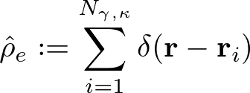




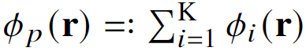
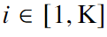
SCFT Build-up — Partition Function
Semicanonical partition function
Canonical in polymer, grand canonical in ions and solvent
Particle-to-field transformations
Hubbard-Stratonovich transformation
Saddle-point approximation
Block copolymer formalism

Slide 8







SCFT Build-up — Free Energy, SCF Eqns
Variational Free Energy
After statistical average over grafting surface (x-y plane)
Functional Minimization
SCF Equations

Slide 9






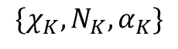
SCFT Build-up — SCF Eqns, cont.
Mean-field Poisson-Boltzmann Equation
Modified Diffusion Equation
Block K
$$\{χ_{K},N_{K}, α_{K}\}$$
Block 2
Block 1

Slide 10


Outline
SCFT Build-up
Systematic Study (Solubility vs. Internal Charge)
Internal Structure of xC
Experimental Application (Neurofilament-Heavy)
Cooperative Collapse of the Dilute Layer
Experimental Characterization (Reflectivity)
Future Work

Slide 11





Solubility sweep, $α=0.40$
Thresh
Minimum Free Energy Conformations
Grouped by “Conformation”
111
SCF Eqns

Slide 12


Solubility sweep, $α$ = 0.40, cont.

Slide 13


Solubility at Different Internal Charges

Slide 14


Internal Structure of xC conformations
Two candidates with identical averaged density profiles
2C
4Cd
“Locked-in-layer”
“Pearl-necklace-like”
(Endpoint densities x 30)

Slide 15


Outline
SCFT Build-up
Systematic Study (Solubility vs. Internal Charge)
Internal Structure of xC
Experimental Application (Neurofilament-Heavy)
Cooperative Collapse of the Dilute Layer
Experimental Characterization (Reflectivity)
Future Work

Slide 16




Protein Coarse-graining
Simplifying protein charge distribution is non-trivial
A straight-forward method is to monitor the cumulative sum (cusum)
Sample sequence:
HHHHHHHHHHHHHHH DDDDDDDDDDDDDDDDDDDDDDDDDDDDDD KDDDHHK KDDDHHK KDDDHHK KDDDHHK KDDDHHK KDDDHHK KDDDHHK KDDDHHK KDDDHHK KDDDHHK

Slide 17


Application to NFH, pH 2.4

Slide 18


Cooperative Collapse of the Dilute Phase
What changes are occurring within NFH during 3x decrease?
Dramatic collapse
2Cd
2C
1C
“Cooperative collapse”

Slide 19
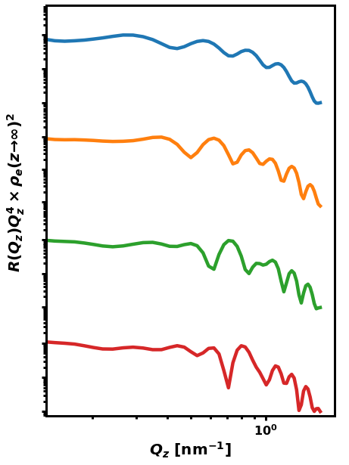

Outline
SCFT Build-up
Systematic Study (Solubility vs. Internal Charge)
Internal Structure of xC
Experimental Application (Neurofilament-Heavy)
Cooperative Collapse of the Dilute Layer
Experimental Characterization (Reflectivity)
Future Work

Slide 20


Reflectivity — Method
Validate results by finding layered structures in PEBs
X-ray or neutron reflectivity for characterization of layered films
Specular part of wave scattering vector
Master Equation: Relates density changes to momentum transfer

Slide 21


Reflectivity — Characteristic Spectra
X-ray and neutron reflectivity
Direct information on polymer internal structure
Prior knowledge of possible conformations necessary
Master Equation
(Reinhardt, et. al. Macromolecules, 2013)

Slide 22
Outline
SCFT Build-up
Systematic Study (Solubility vs. Internal Charge)
Internal Structure of xC
Experimental Application (Neurofilament-Heavy)
Cooperative Collapse of the Dilute Layer
Experimental Characterization (Reflectivity)
Future Work

Slide 23
Future Work
xC extension:
Response to foreign species (e.g. spherical tip of AFM)
Response to brush-brush
Multivalent ions (ion correlations)
Experimental Collaborations
Validation with reflectivity
NF(L/M/H) blends for study of biological neurofilaments
Erika Ding, Prof. Sanjay Kumar
Nafion aggregation using SCFT-generated force fields and MD
Siddarth Rajupet, Prof. Clayton Radke

Slide 24
Summary
NFH dramatic collapse caused by cooperative interactions
xC conformations exist at high internal repulsion
Each chain in xC(d) “locked-in-layer”
Characteristic reflectivity spectra can be generated rigorously

Slide 25




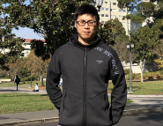

Acknowledgements
Wang Group
Prof. Rui Wang
Dr. Chao Fang
Luofu Liu
Nikhil Agrawal
Dr. Chao Duan

Slide 26
Summary
Paste from above when finished

Slide 27
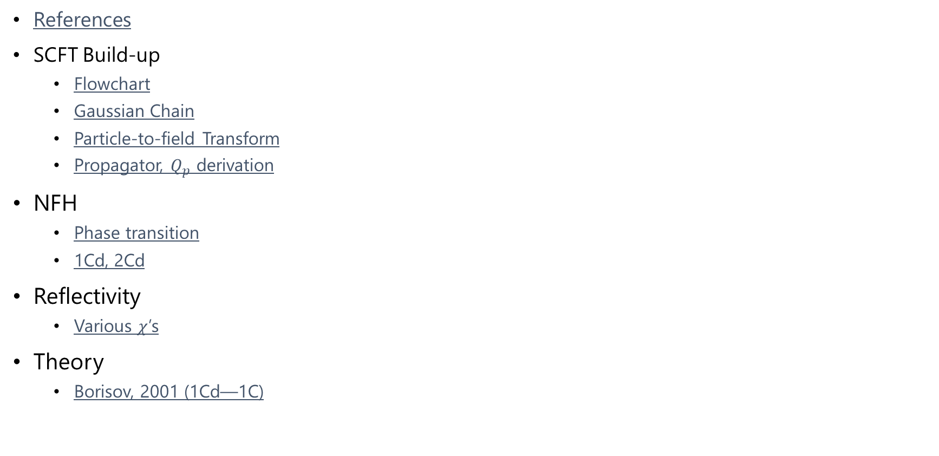
SI: Table of Contents
References
SCFT Build-up
Flowchart
Gaussian Chain
Particle-to-field Transform
Propagator, $Q_{p}$ derivation
NFH
Phase transition
1Cd, 2Cd
Reflectivity
Various $χ$’s
Theory
Borisov, 2001 (1Cd—1C)

Slide 28
References
Abnormal NF image: Yuan, A., Rao, M. V., Veeranna, & Nixon, R. A. (2012). Neurofilaments at a glance. Journal of Cell Science, 125(14), 3257–3263. https://doi.org/10.1242/jcs.104729
Andelman, D. (2006). Introduction to electrostatics in soft and biological matter. In W.C.K. Poon, D. Andelman (Eds.), Soft Condensed Matter Physics in Molecular and Cell Biology (pp. ). CRC Press.
Srinivasan, N., Bhagawati, M., Ananthanarayanan, B., & Kumar, S. (2014). Stimuli-sensitive intrinsically disordered protein brushes. Nature Communications, 5(1), 5145. https://doi.org/10.1038/ncomms6145
Schreiber, F., & Gerlach, A. (n.d.). X-Ray and Neutron Reflectivity. Department of Chemistry - University of Oxford. www.physchem.ox.ac.uk/~fs
Reinhardt, M., Dzubiella, J., Trapp, M., Gutfreund, P., Kreuzer, M., Gröschel, A. H., Müller, A. H. E., Ballauff, M., & Steitz, R. (2013). Fine-Tuning the Structure of Stimuli-Responsive Polymer Films by Hydrostatic Pressure and Temperature. Macromolecules, 46(16), 6541–6547. https://doi.org/10.1021/ma400962p

Slide 29





SCFT Build-up — Flowchart
PDE Solve (for iteration k)
Propagate (using PDE solutions)
Check (for self-consistency)
Update (if not satisfied)
Anderson Mixing
Simple Mixing
Notation slightly incorrect but changed for clarity. w^{k} = f(w^{k+1/2}, w^{k-1}), where w^{k+1/2} is from SCFT calculations (\phi remains ^{k})

Slide 30





Gaussian Chain
Free internal segments
Large N, kb << 1

Slide 31
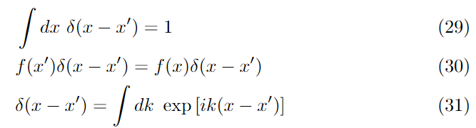
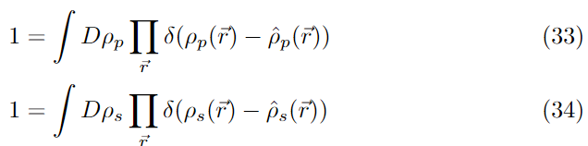
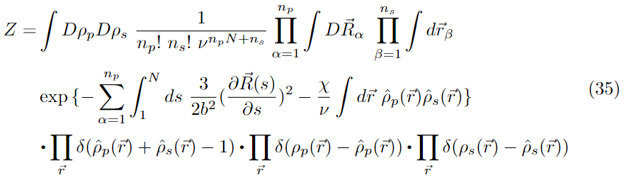
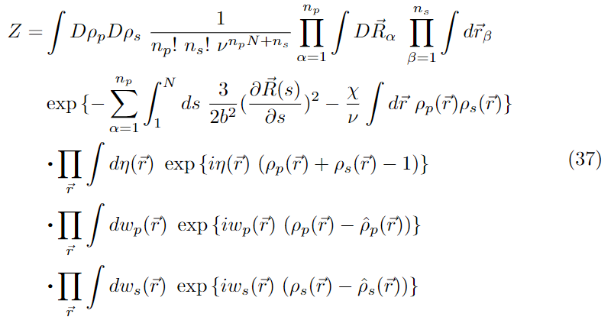
Particle-to-Field Transform
Next slide

Slide 32




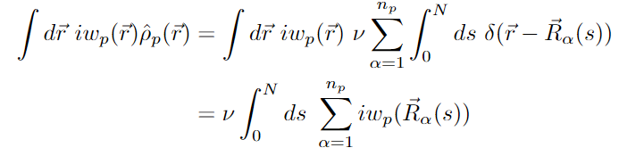
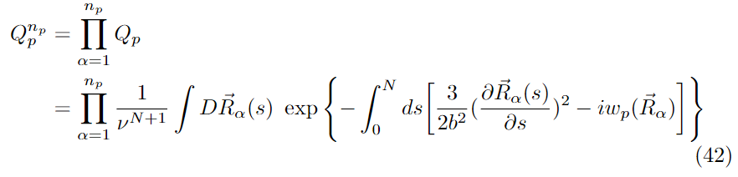

Propagator, $Q_{p}$ derivation
Prev slide

Slide 33
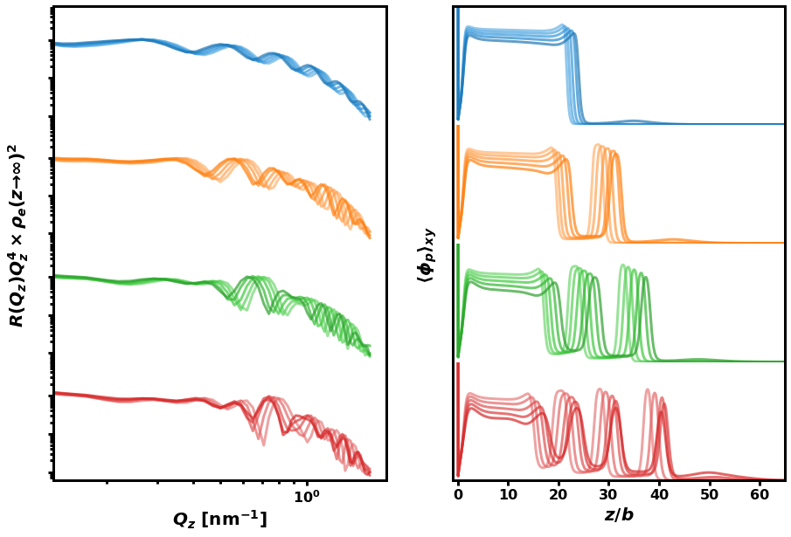

Reflectivity — Different $χ$’s

Slide 34


Borisov previous theory
Klushin, Birshtein, Amoskov. (2001). Macromolecules, 34.

Slide 35

NFH Phase Transition

Slide 36

NFH 1Cd, 2Cd

